Slide 1



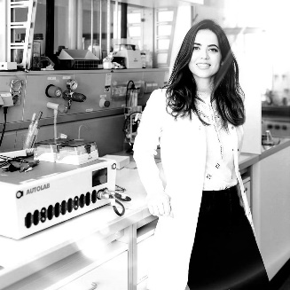
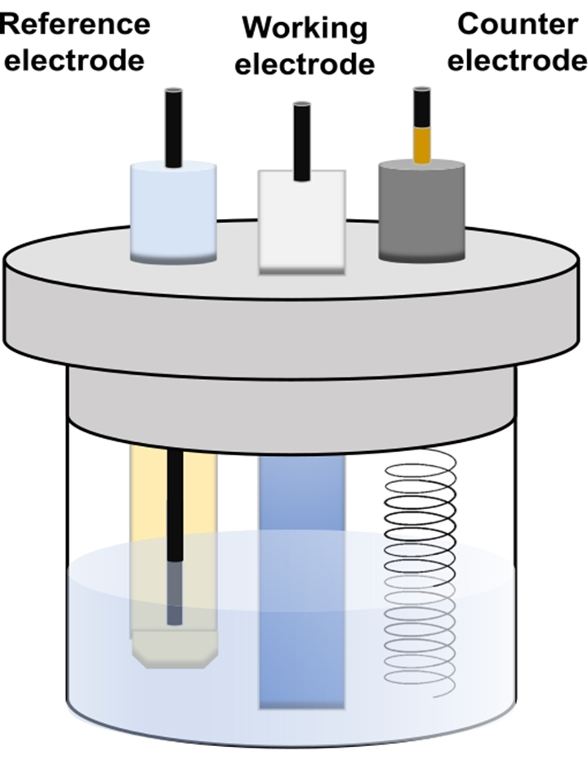
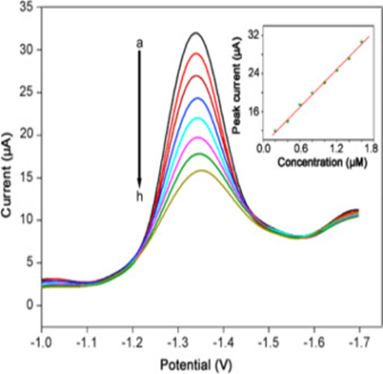
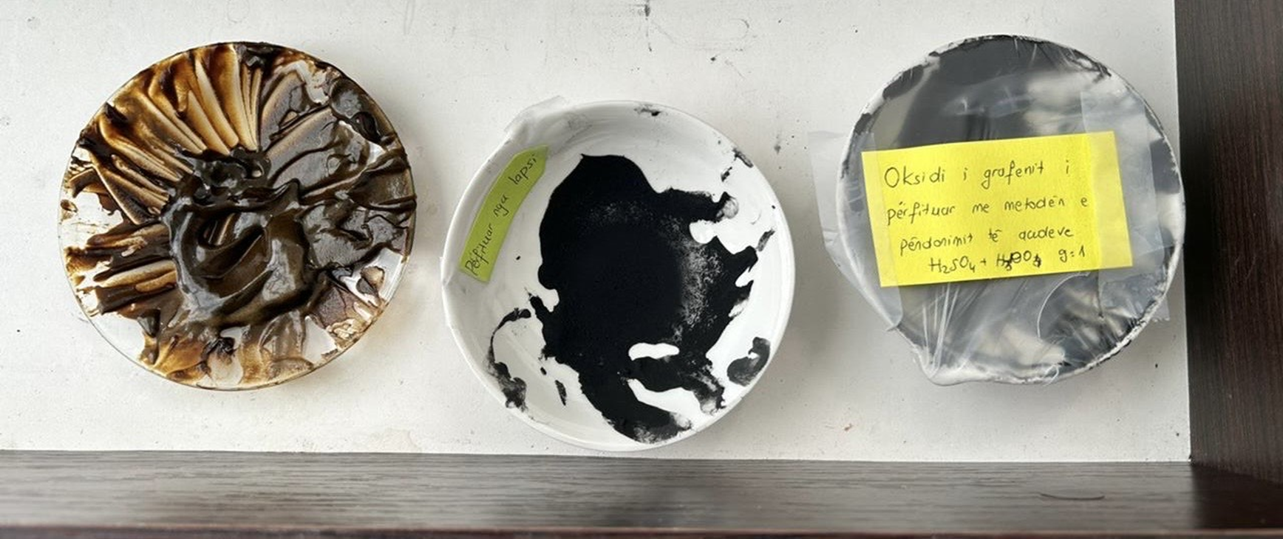
Chemical sensors based on nanomaterial’s for advanced studies and analysis group
Contact person/Group leader:
Dr.sc. Albana Veseli
Affiliation
Department of Chemistry, Faculty of Natural and Mathematical Sciences, University of Prishtina ‘’Hasan Prishtina
Mail address
’’ Str. George Bush n.n. 10000 Prishtina, Republic of Kosova
Email/website
albana.veseli@uni-pr.edu
Group Members
Dr.sc. Albana Veseli, Prof.ass. Flamur Sopaj
Google Scholar
https://scholar.google.com/citations?user=P-xYxLUAAAAJ&hl=en
https://www.researchgate.net/profile/Albana-Veseli?ev=hdr_xprf&_tp=eyJjb250ZXh0Ijp7ImZpcnN0UGFnZSI6Il9kaXJlY3QiLCJwYWdlIjoiX2RpcmVjdCIsInBvc2l0aW9uIjoiZ2xvYmFsSGVhZGVyIn19
Research Gate
Research lines
The designing of electrochemical sensors based on carbon nanomaterial's for human, food and environmental sample analysis.
Organic pollutants degradation in water media, using advanced oxidation and electrochemical advanced oxidation processes.

