Slide 1




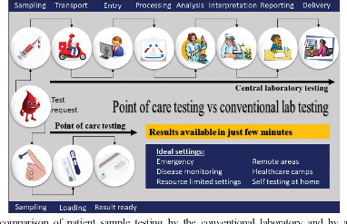
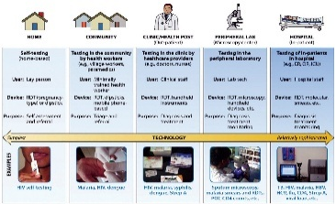
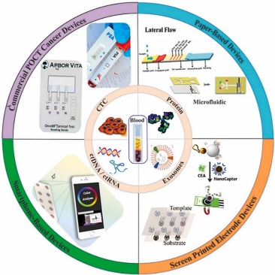
POINT-OF-CARE DIAGNOSTICS RESEARCH GROUP
Contact person/Group leader:
Prof. Assoc. Dr. Aurel YMETI
Affiliation
Department of Biosciences & Engineering, Western Balkans University, Albania
Mail address
Highway Tiranë-Durrës, KM 7, Kashar, Tirana, Albania
Email/website
aurel.ymeti@wbu.edu.al; a.ymeti@gmail.com
https://wbu.edu.al/en/academic-staff/prof-asoc-dr-aurel-ymeti
Group Members
Prof. Assoc. Dr. Aurel Ymeti; PhD Retina Capuni, MSc Brunilda Mezani; BSc. Gloriano Sherifi
Google Scholar
https://scholar.google.com/citations?user=R3SafTYAAAAJ&hl=en
Research Gate
https://www.researchgate.net/profile/Aurel-Ymeti
Research lines
Mission/Vision: Research & development, validation and implementation of POCT devices for early disease detection and preventive healthcare.
Diagnosis and monitoring of lifestyle-related diseases, incl. cancer, diabetes type 2, COPD and cardiovascular diseases based on rapid and accurate detection of health biomarkers at the Point-of-Care settings, e.g. GP practices, community centers, and at home.
Development of POC devices using various biosensing principles such as photonic integrated biosensors, lateral flow assays, electrochemical sensors, etc.
Rapid Sepsis diagnosis near patient bed based on specific, multiplex detection of relevant biomarkers such as IL-6 and CRP using LFA tests.

