Slide 1


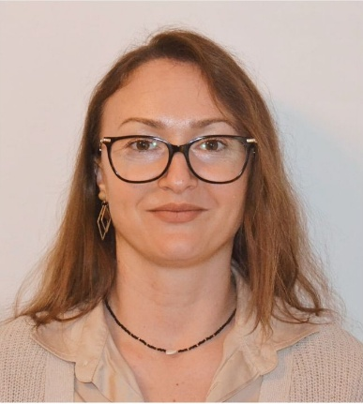
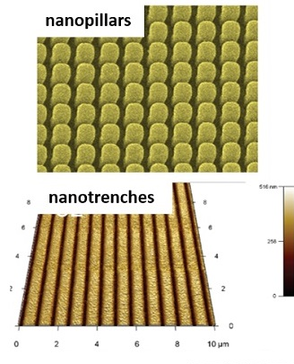
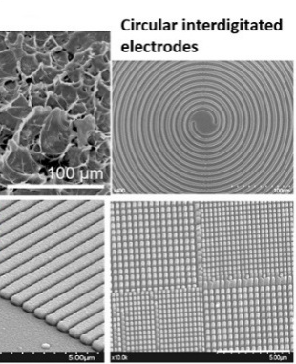
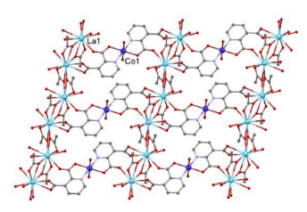
Miniaturization and Design of Functional Surfaces and Nanomaterials RESEARCH GROUP
Contact person/Group leader:
Dr. Nicoleta Elena DINA
Affiliation
National Institute for R&D of Isotopic and Molecular Technologies, ROMANIA
Mail address
67-103 Donath Street, 400293, Cluj-Napoca, ROMANIA
Email/website
nicoleta.dina@itim-cj.ro // https://en.itim-cj.ro/portfolio/dina-nicoleta/
Dr. Nicoleta Elena DINA, Dr. Alexandrina NAN, Dr. Anca Petran, Dr. Alia Colniță,
Dr. Daniel Marconi, Dr. Ioana Brezeștean, Dr. Andra-Sorina Tătar
Dr. Natalia Terenti, Dr. Teodora Radu, Dr. Alexander Bunge
Group Members
Google Scholar
https://scholar.google.com/citations?user=2tfLLikAAAAJ&hl=en
Research Gate
https://www.researchgate.net/profile/Nicoleta-Mircescu?ev=hdr_xprf
Research lines
The design and fabrication of micro-nano-structured hybrid materials that will later constitute support surfaces for detection based on surface-enhanced Raman (SERS), Surface Plasmon Resonance (SPR), electrochemical impedance (EIS) or surface-enhanced fluorescence (SEF)
Surface modification of materials (bulk, powdered or nanomaterials – insulator, semi-conductor or conducting ones) by physical deposition techniques such as: molecular-beam epitaxy (MBE)
The fabrication of well-defined nanostructures as bio-inspired, functional coatings and surfaces with applications in circular bio-economy, medicine, industry and anti-counterfeiting products
Design, synthesis, and structural characterization of coordination polymers, homo-/heterometallic coordination systems and magnetic nano-particles/nano-clusters/nano-cubes and polymers like: polyesters, polyphenols, polyphenylamines, polyanilines with application in nanomedicine, energy, water depollution, photocatalysis, thermal-conductivity, supercapacitor devices.

