Slide 1

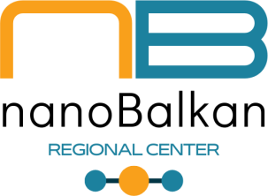
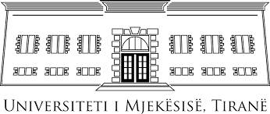
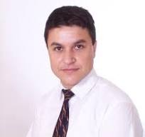
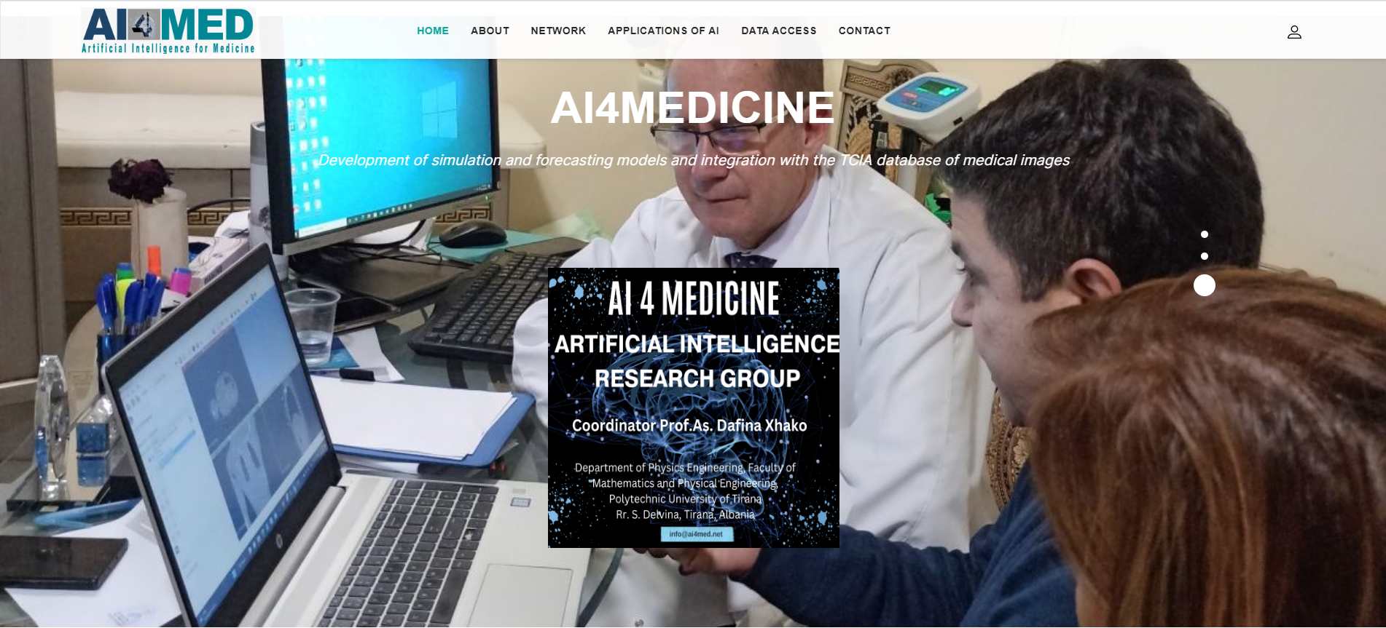
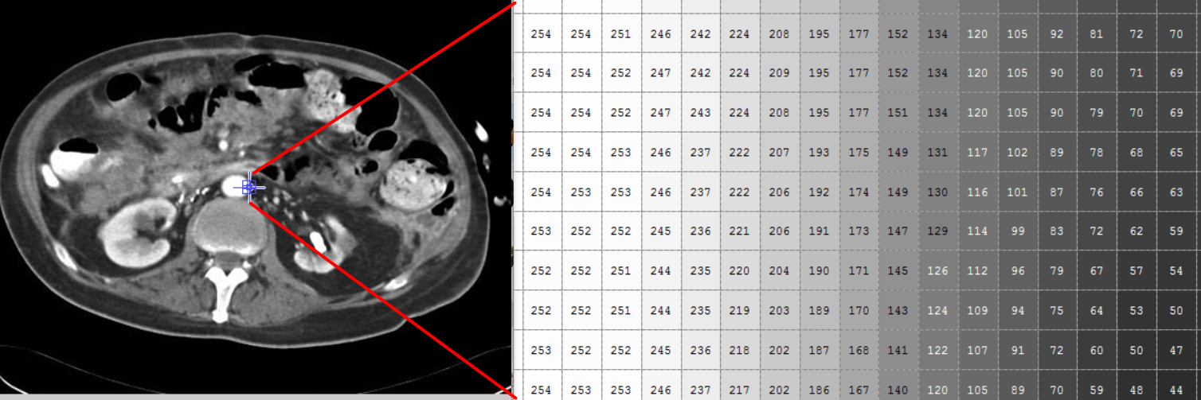
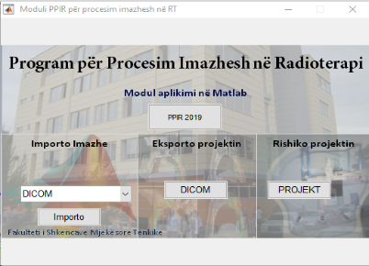
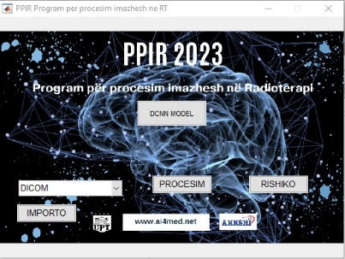
AI APPLICATIONS IN MEDICAL IMAGING RESEARCH GROUP
Contact person/Group leader:
Prof. Asoc. Niko Hyka
Affiliation
Department of Diagnostics, Faculty of Medical Technical Sciences, University of Medicine,Tirana
Mail address
Rr. Kongresi i Manastirit, FSHMT-QSUNT, Tirana, Albania
Email/website
niko.hyka@umed.edu.al, https://ai4med.net/
Group Members
Prof. Asoc. Niko Hyka, Prof.Asoc. Dafina Xhako, Prof. Kita Sallabanda, Dr. Albana Shahini, Dr. Altina Xhaferi, MSc.Elda Spahiu, MSc.Suela Hoxhaj
Google Scholar
https://scholar.google.com/citations?hl=en&user=9xQDI34AAAAJ
Research Gate
https://www.researchgate.net/profile/Kledi_Xhaxhiu
Research lines
Developing new AI simulation and predictive models for implementation in the field of medical imaging and radiotherapy.
Establishing AI models for training purposes, in diagnostic and therapeutic centers, to increase the accuracy level of the examination and to eliminate or minimize errors made during diagnostics / treatment.
Application of artificial intelligence simulation and prediction models using large number of imaging data obtained from several diagnostic centers in Albania
Increasing the cooperation between institutions and professionals with long scientific expertise and involving young researchers in new technologies and applications in biomedical sciences.

