Slide 1



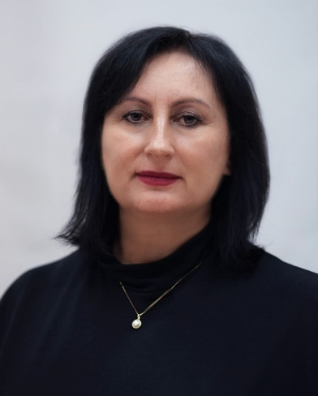
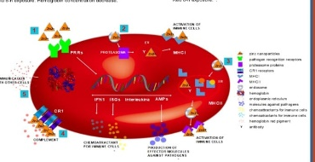
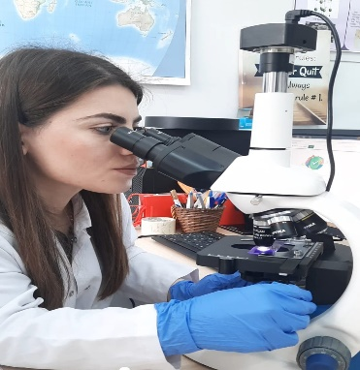
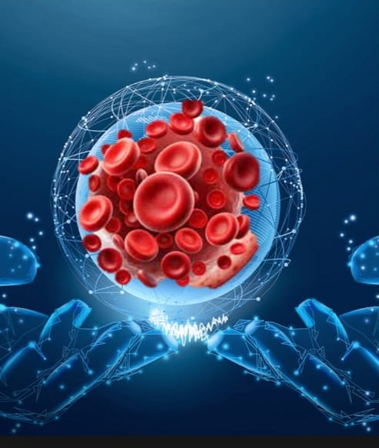
NANOTOXICITY AND BIOMARKERS OF EFFECT RESEARCH GROUP
Contact person/Group leader:
Prof. Dr. Valbona ALIKO
Affiliation
Department of Biology, Faculty of Natural Sciences, University of Tirana, Albania
Mail address
valbona.aliko@fshn.edu.al; valbona.aliko@unitir.edu.al
Email/website
https://www.fshn.edu.al/departments/departamenti-i-biologjise/personel/prof-dr-valbona-aliko
Group Members
Prof. Dr. Valbona Aliko; Prof. Asoc. Ledia Vasjari; Prof. Asoc. Eliana Ibrahimi; Dr.Fundime Miri; Dr. Isidora Gjata, Dr. Eldores Sula; Dr. Blerta Turani; Ph.D. Erion Sukaj;
Google Scholar
https://scholar.google.com/citations?user=S9zgjp4AAAAJ
Research Gate
https://www.researchgate.net/profile/Valbona-Aliko?ev=hdr_xprf
Research lines
Nanotoxicity Mechanisms – Investigating cytotoxicity, oxidative stress, inflammation, and genotoxicity induced by nanoparticles.
Biomarkers of Exposure and Effect– Identifying molecular and cellular biomarkers for assessing nanoparticle interactions with biological systems.
Computational and AI-Based Toxicology– Applying modeling and artificial intelligence for toxicity prediction and data analysis.
Environmental and Biomedical Impacts– Evaluating nanoparticle bioaccumulation, biodistribution, and safety in ecosystems and medical applications.

